Slide 1
Client Privacy Preservation via Secured DNS
Presented By: Feisty Forwarders
Mentor – Dr. Amrita Mishra
“You are online, so are the bad guys!”
Team Lead –
Nidhish Bhimrajka
Team Members –
Daksh Agarwal
Harshita Gupta

Slide 2
Team Capability
Why we are Great as a team?
Worked together on various projects
Our coordination is well timed
Always eager to learn about new technologies
Always try to improve upon our mistakes
Nidhish Bhimrajka –
Summer Research Intern under Prof. Srinivas Vivek
Worked on optimizing AES (Advanced Encryption Standard) circuit, learnt about Multi-party protocol and various other cryptographic algorithms
Skill-set -
Programming (C/C++, Python, Java, Go, Shell-scripting)
Cryptography, Networking and cyber security

Slide 3
Daksh Agarwal –
Summer Development Project Intern with Prof. T K Srikanth
Successfully implemented a Patient Portal (Full-Stack).
Skill-set -
Good grip on Data Science and Machine Learning
Data structures and Algorithms (Java/C++/Python)
Harshita Gupta -
Research Intern under Prof. Srinivas Vivek
Created an Authentication App for MOSIP organization
Created Digital Logbook under Prof. AS Jawanda
Skill-set -
Full-Stack Development / App Development (MERN Stack)
Networking, Cryptography and Cyber Security
Socket Programming

Slide 4
Motivation
Looming threat of scrutiny on the Internet by a potential spy!!
Can we design a Protocol which -
Hides your IP
Encrypts all the incoming and outgoing traffic.
Project idea based on providing a secure environment to users for surfing the Internet.

Slide 5
What generally happens!!
CLIENT
RESOLVER
Hey! I am 103.232.112.80. What is the IP address of www.xyz.com?
Hey! The IP address of www.xyz.com is 12.12.1.13
IP address of the client is exposed!

Slide 6
Proposed Solution - DNSTAR
Original client query is – What is the IP address of www.xyz.com?
Relay receiving the encrypted query
Decrypts the query using the symmetric key
Hey! I am 202.134.135.32 aahsfjhjasdhfjdajsfhjaj
CLIENT
Hey! I am 103.232.112.80 aahsfjhjasdhfjdajsfhjaj
RELAY
RESOLVER
Hey! kjfghjhgjhfdsjghjasdfg
Hey! kjfghjhgjhfdsjghjasdfg
Client received encrypted response. It decrypts using the symmetric key.
Resolver sending encrypted resolution of the query

Slide 7
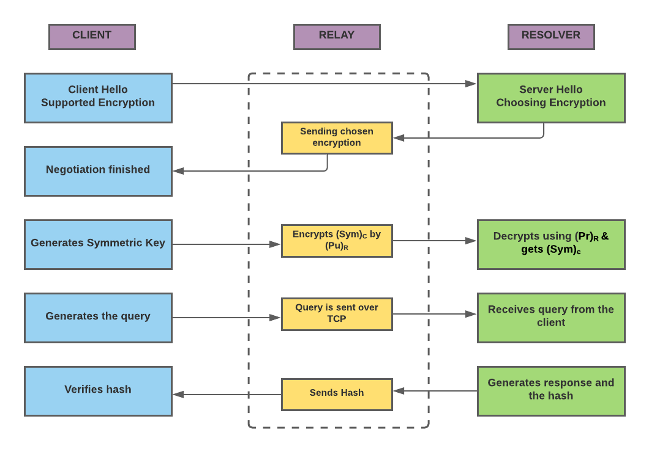
Implementation Details

Slide 8
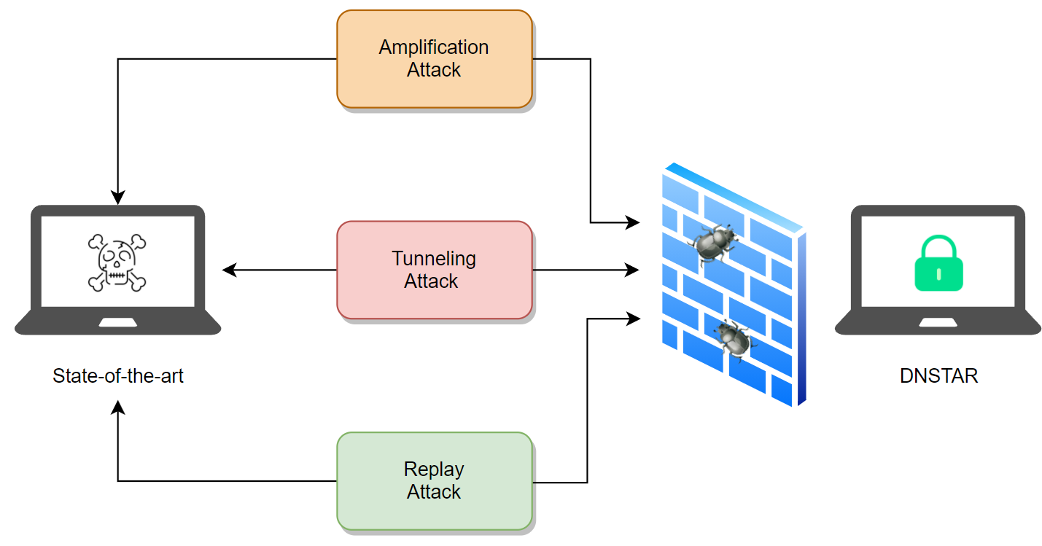
How Our Idea Stands Out
The state-of-the-art implementation lacks data integrity and protection against one or the other kind of attacks

Slide 9
Future Impact of Our Research
The protocol can have its applications in the sectors where client data is being logged by the service providers.
Minimized privacy threat for a user surfing the Internet.

Slide 10
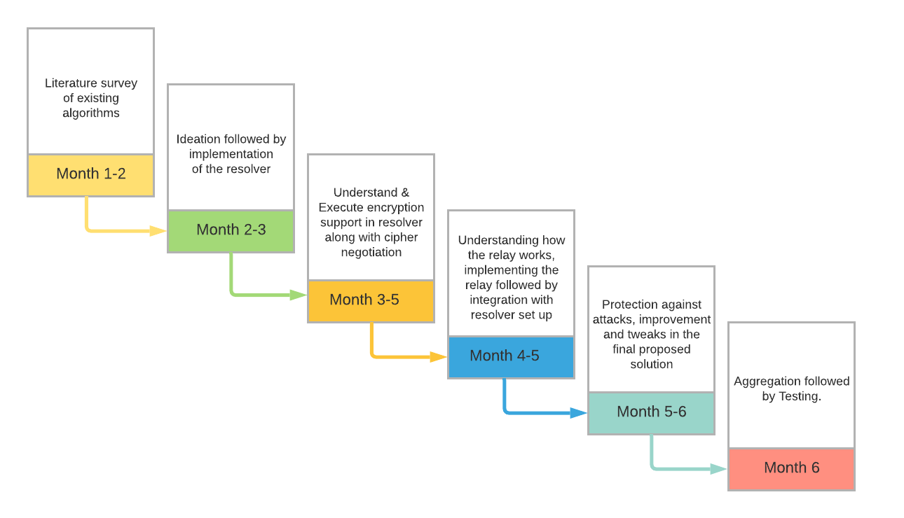
Milestones

Slide 11
Thank You

