Slide 1
ADVANCE HEALTH
CHECKUP FOR DNS

Slide 2
TEAM
VARSHA REDDY
VASAM AADARSH MAHENDRA
KAUSHIK APOORI
Always admire to one statement that I will win definitely but not immediately
I strongly believe that technology can greatly
help in solving day to day problems
I'm always open to opportunities that help
me further in my carrier objectives.

Slide 3
DNS Health Check-up
The present DNS health monitor validates the health of DNS servers having these 5 major factors .
-COHERENCY -INTEGRITY -SPEED -AVAILABILITY -RESILIENCY
EXTERNAL DEPENDENCIES
1. Organization support
2. Interaction with operation teams
3. AI experts

Slide 4
Prevention is better than cure.
To have a Pre-Analysis of firewall along with other health factors.
To have automated interface without much manpower involved.
WHY
Automated reports through AI technology along with status and percentage analysis of firewall
Pre Security Measures
Notifications at beforehand will be sent to operation teams
WHAT
Encrypting the AI script to the organization health checkup source.
When the intruders or cyberattacks try to attack, AI will react by sending the notifications with the report.
HOW

Slide 5
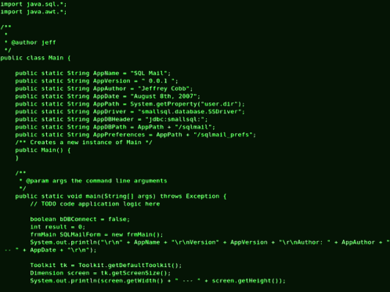
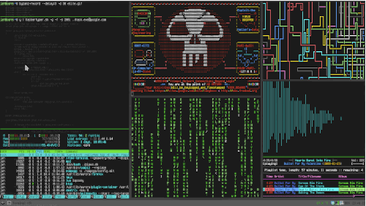
Why?
20%
60%
100%
FIREWALL

Slide 6
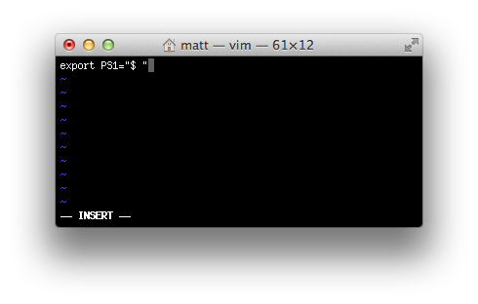
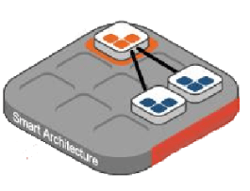
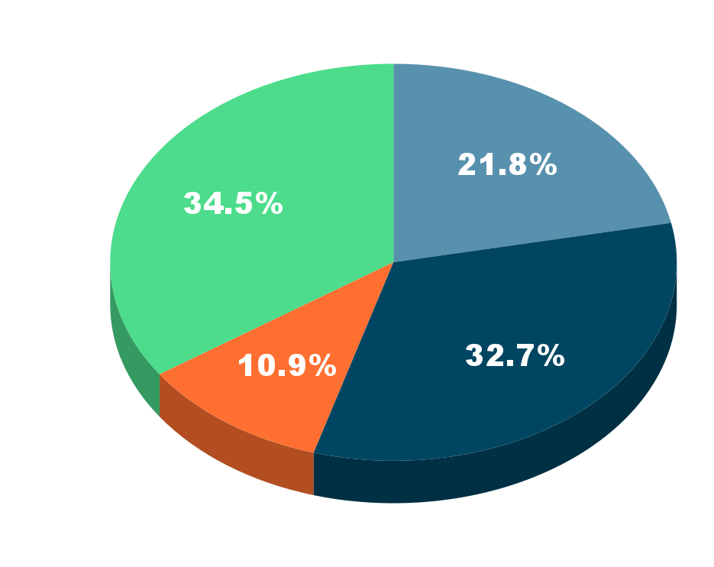
What & How?
HACKER!!!
Input
FIRE WALL
________……._____::::___________,,,,___________||||______…._______—-_____…..______—-____!!!!!
WARNING!!!
error!!!
Output
UNSUCCESSFUL ATTEMPT
DNS
Someone is trying to enter into your SITE

Slide 7
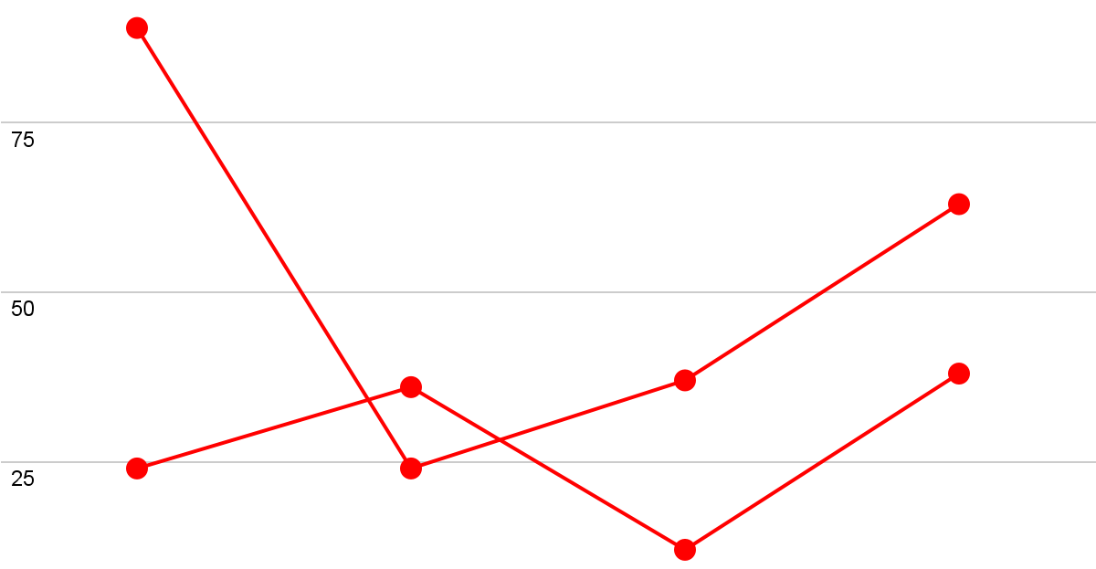
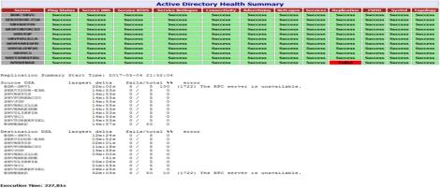
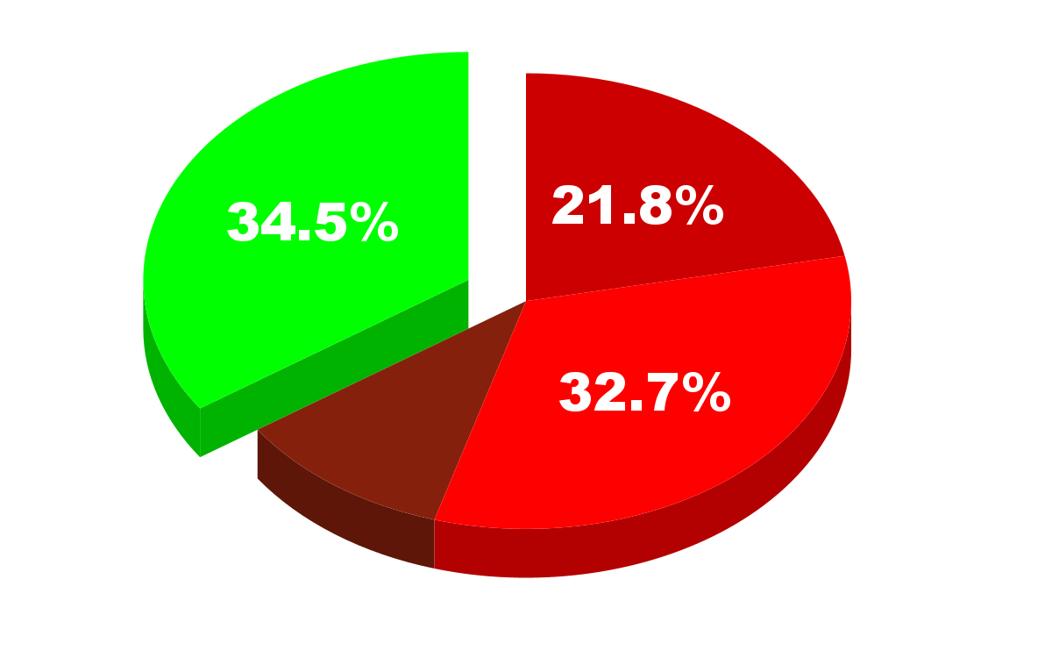
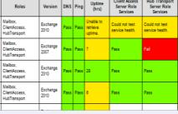
Result
Reports
USER
Firewall Status: 78%
Malware attacks: NO
Your Website is protected

Slide 8
Merits & Scope
ACCURATE : Stop end users from visiting malicious and inappropriate sites
EASY: Deploy in minutes, and you can be filtering the Internet traffic.
PRE-SECURITY : Can be prepared for upcoming attacks based on report.
ADVANCE ANALYSIS: Complete analysis of the firewall gateway
SMART WORK: Generating automated reports through AI without manpower.
STAY SAFE AND PROTECTED.
GREAT & ACCURATE PREDICTIONS

